Slide 1



Determination of emerging substances in top predators and their prey using state-of-the-art chemical monitoring methods.
Nikiforos Alygizakis, Ph.D.
LIFE17 ENV/SK/000355
www.lifeapex.eu
ESB Conference 2019, Stockholm, 3rd June 2019

Slide 2
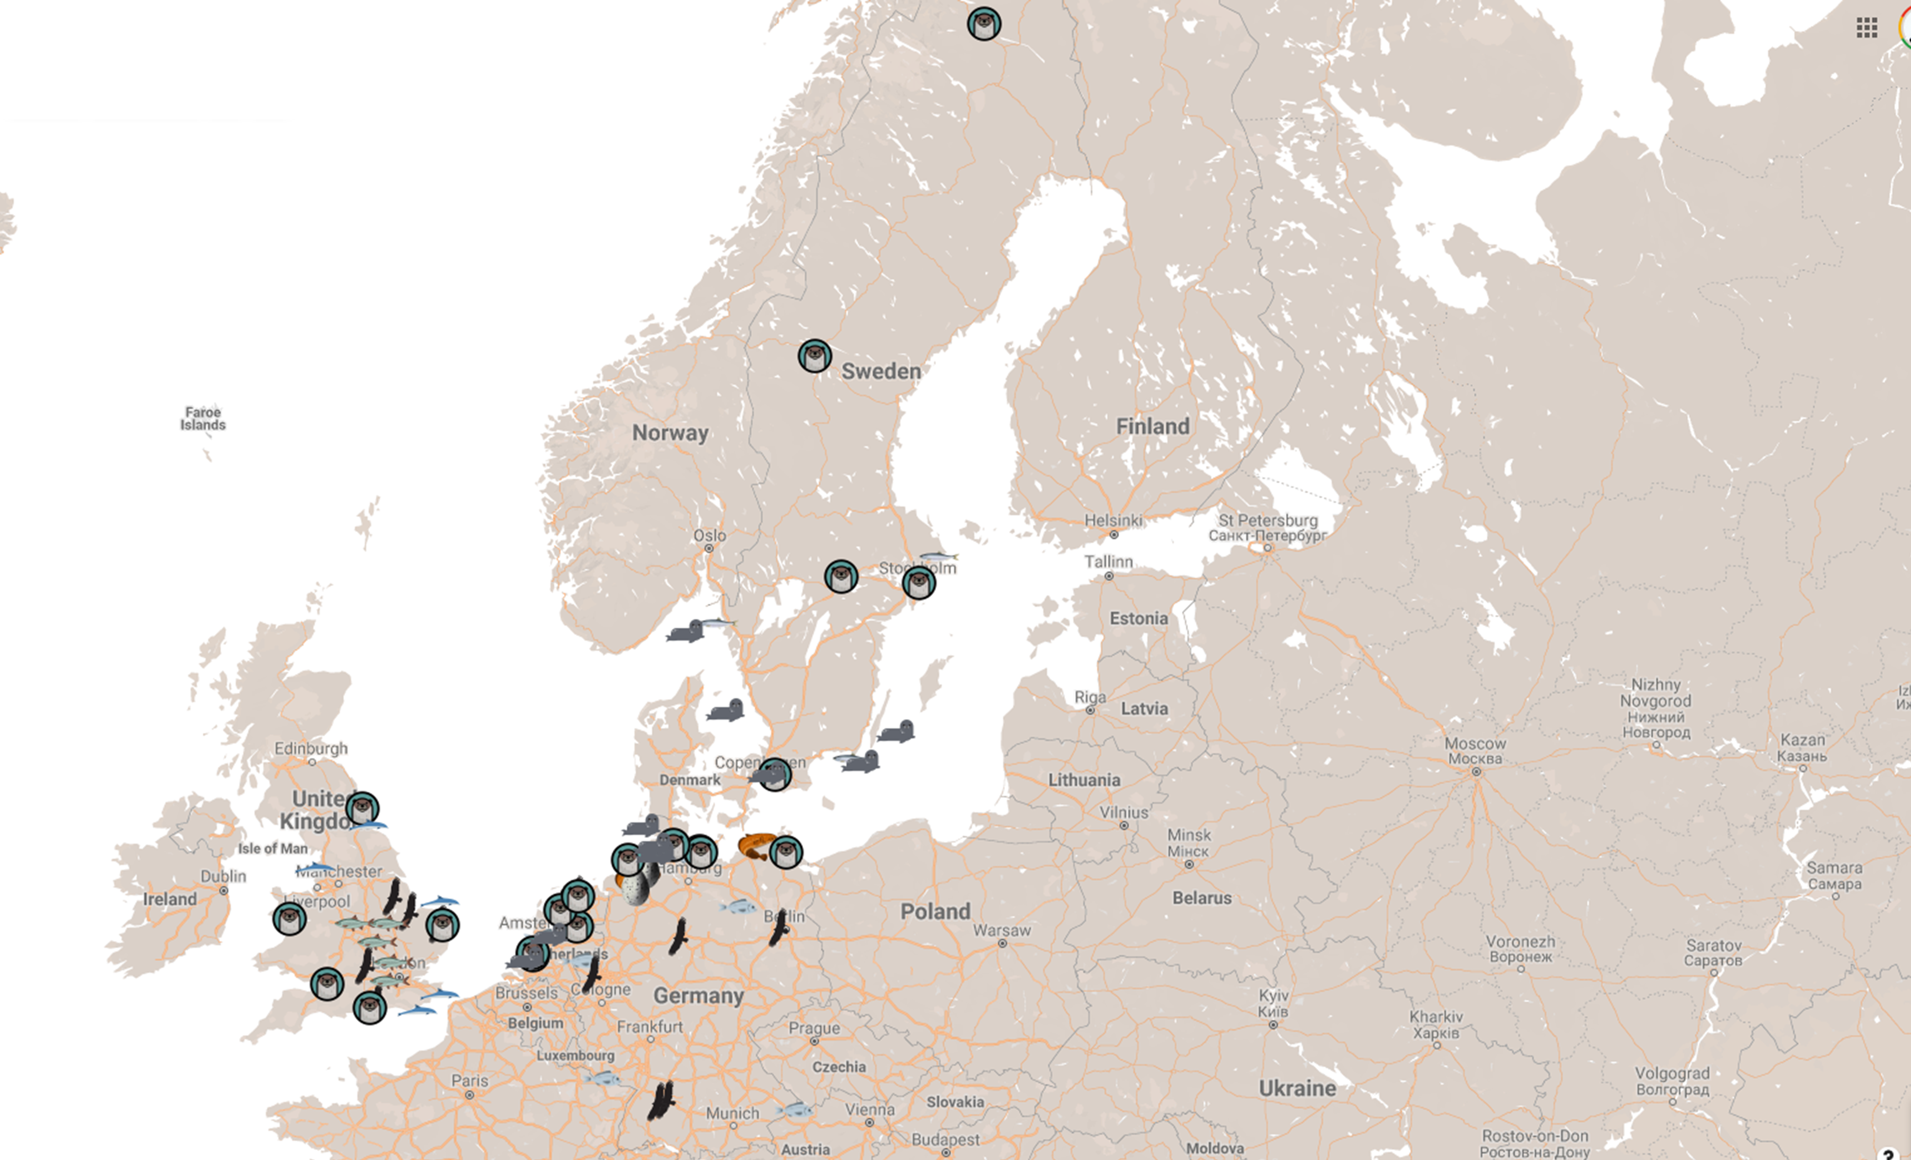






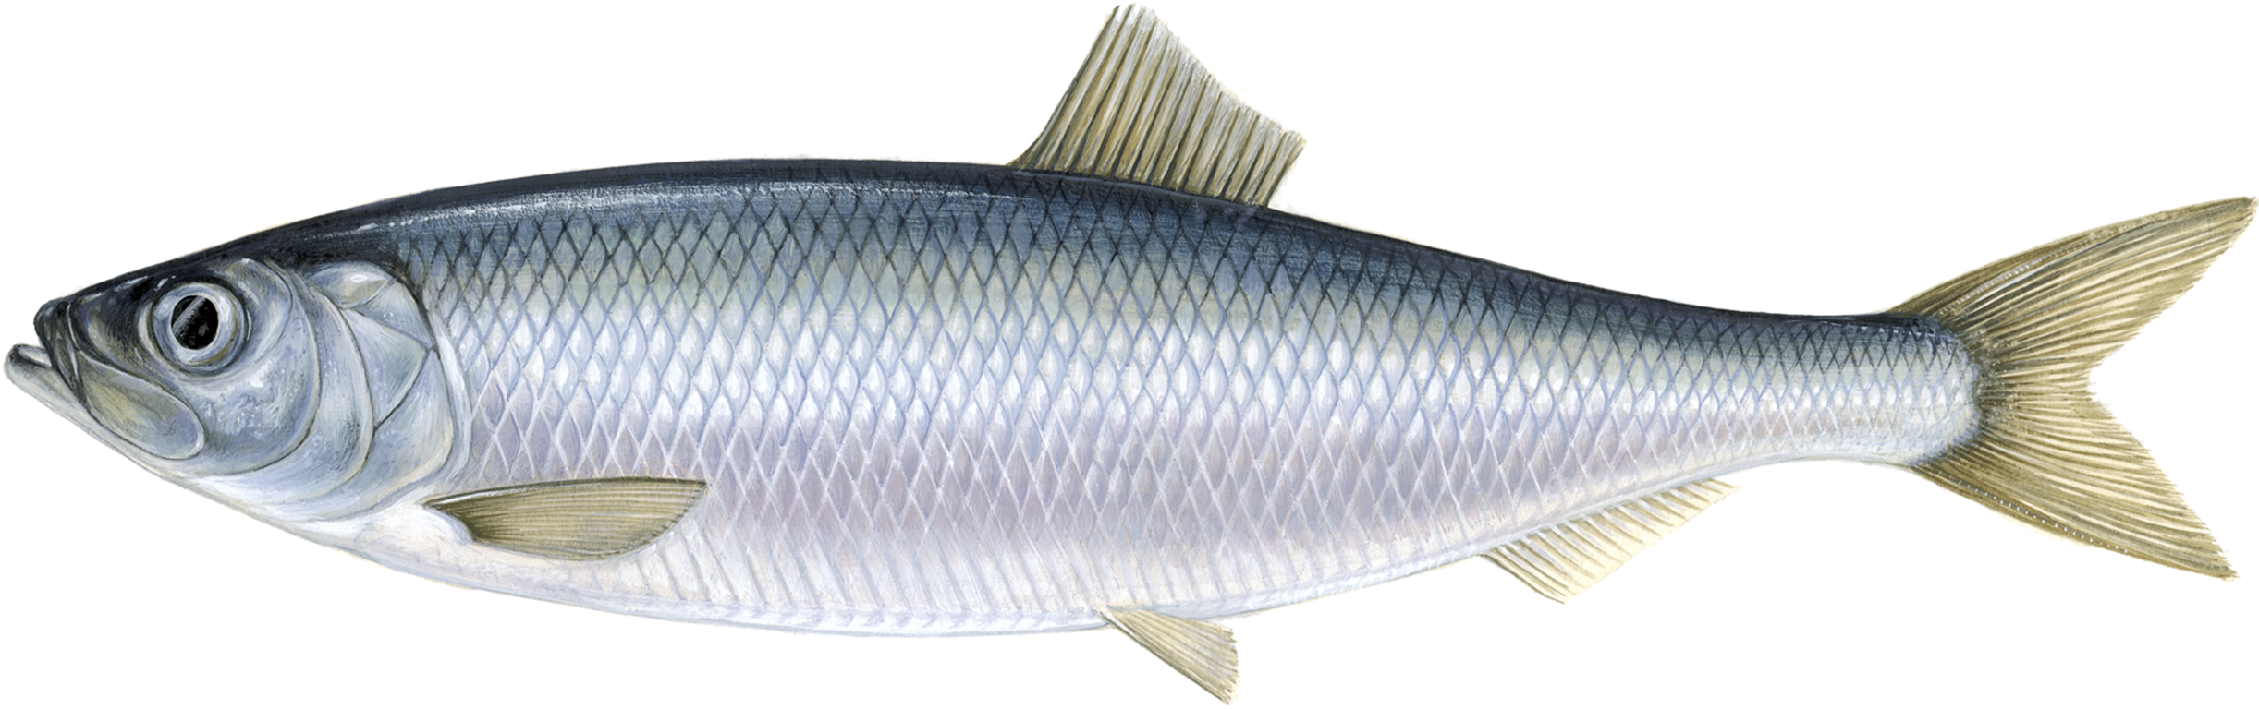
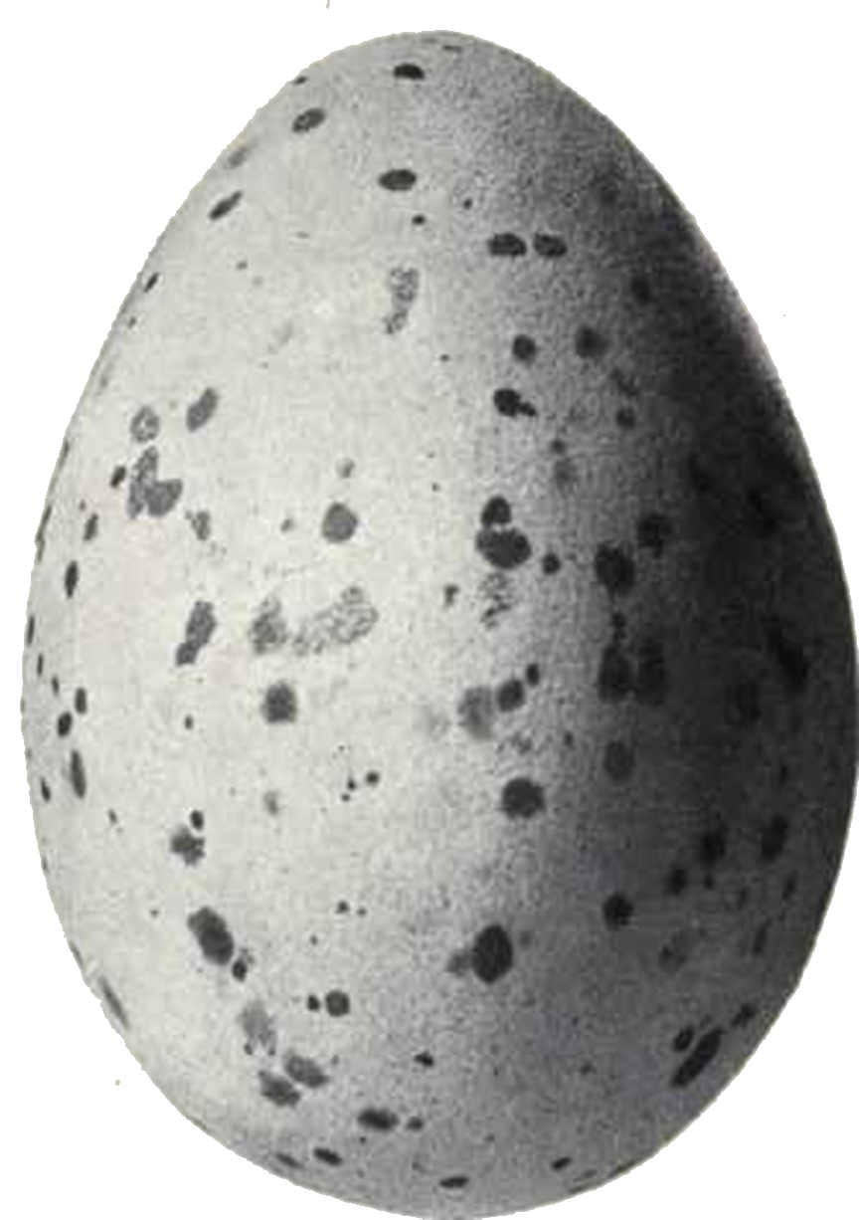







Pray
Top predators
&
Gathering of 67 samples (Tier 1)
Bream
Buzzard
Eelpout
Harbor seal
Roach
Eurasian otter
Herring
Herring gull egg
Harbour Porpoise
https://tinyurl.com/y2u2xqpk

Slide 3
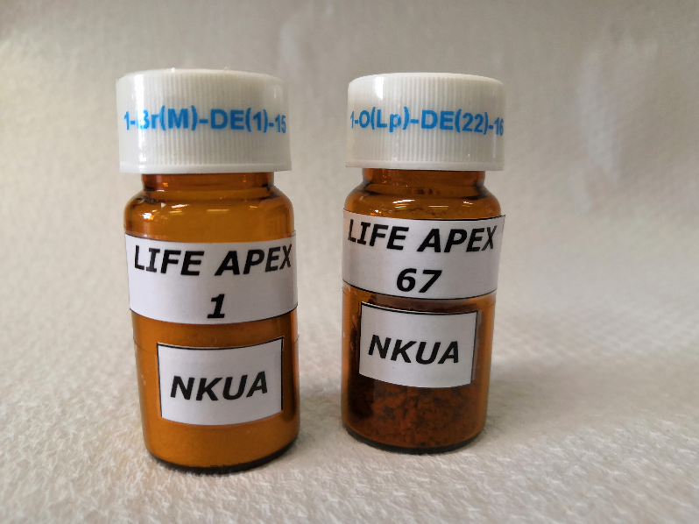
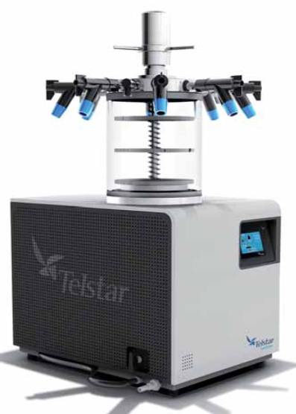
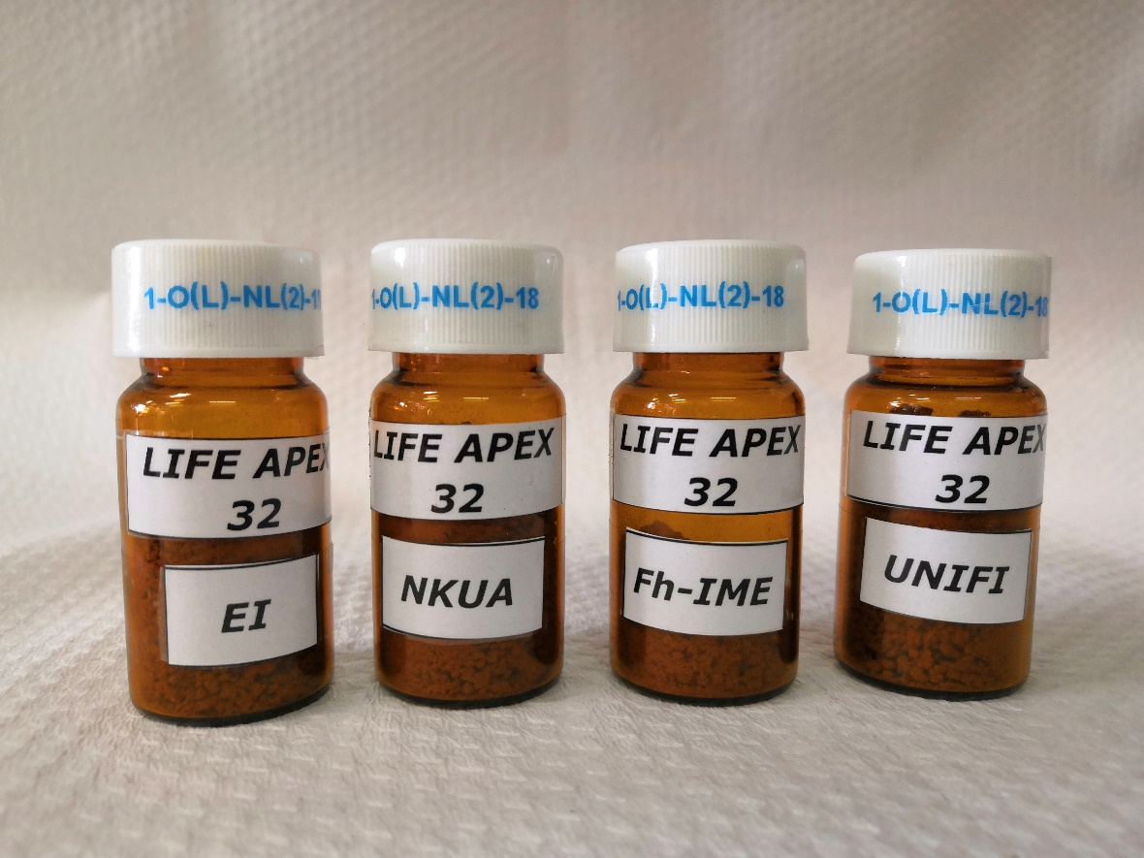
Sample preparation
Distribution of sub-samples to:
EI
Fh-IME
UNIFI
Lyophilisation & Homogenization

Slide 4
Activities - Analysis
Target analysis of c. 30 well-known substances
PFAS (PFSA, PFCA, PFOS, PFOA, PFHxSA, PFNA and PFDA, and their precursors)
Dioxins and dioxin-like compounds
Chlorinated alkanes
Novel organophosporous flame retardants and Declorane
Mercury
PCBs, OCPs, PBDEs & Hexabromocyclododecane
Target analysis of >2,400 emerging contaminants
LC-HRMS
GC-HRMS
Non-target screening
LC-HRMS
GC-HRMS
GC-MS (EI/PCI/NCI)
UoA
EI
Fh-IME
UNIFI
UoA
UoA
EI

Slide 5
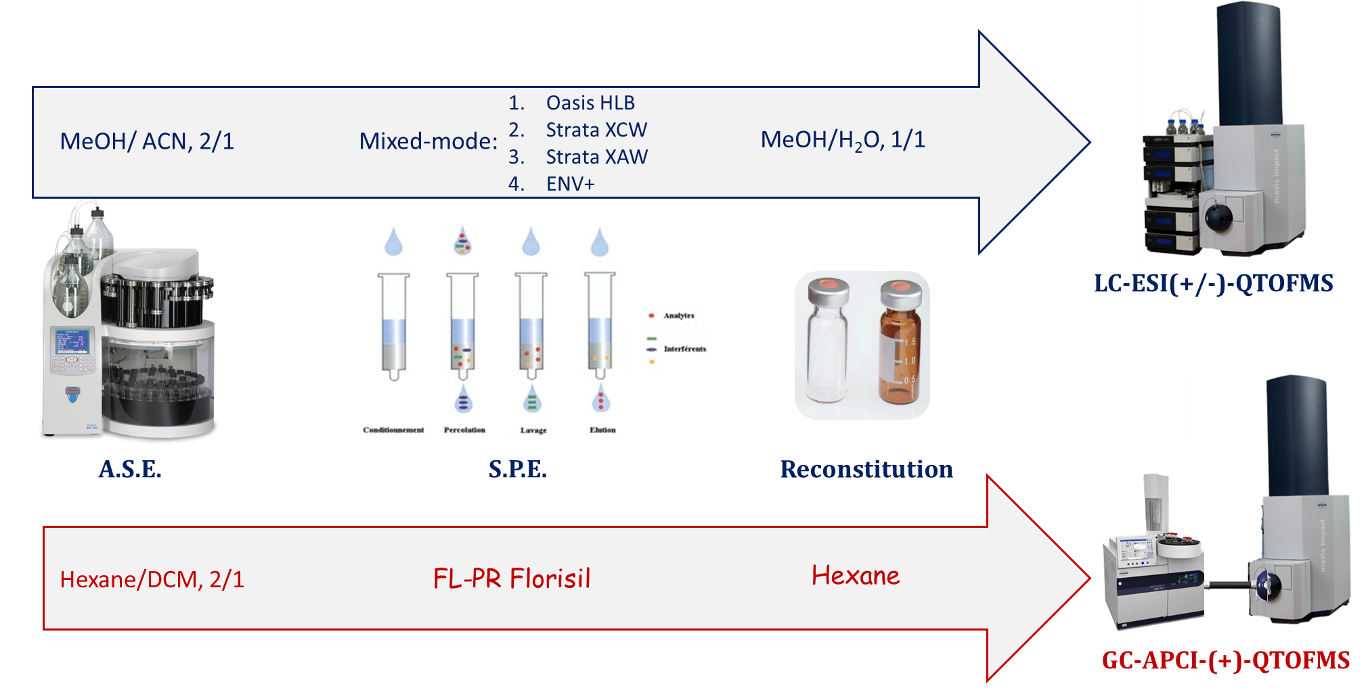
Sample preparation – HRMS analysis

Slide 6
Wide-scope target screening
Databases are continuously being updated!
> 2,400 compounds databases for LC-ESI-QTOFMS & GC-APCI-QTOFMS
Personal care products
Steroids & hormones
Pharmaceuticals (>450)
Antibiotics (>50)
Illicit drugs and NPS (>500)
Industrial Chemicals (>100)
&
Transformation Products/ Metabolites
Pesticides (>900)
Sweeteners
Surfactants
Biocides
QACs
PAHs
OCPs
PCBs
Pesticides
PCNs
PBDEs
FAMEs

Slide 7
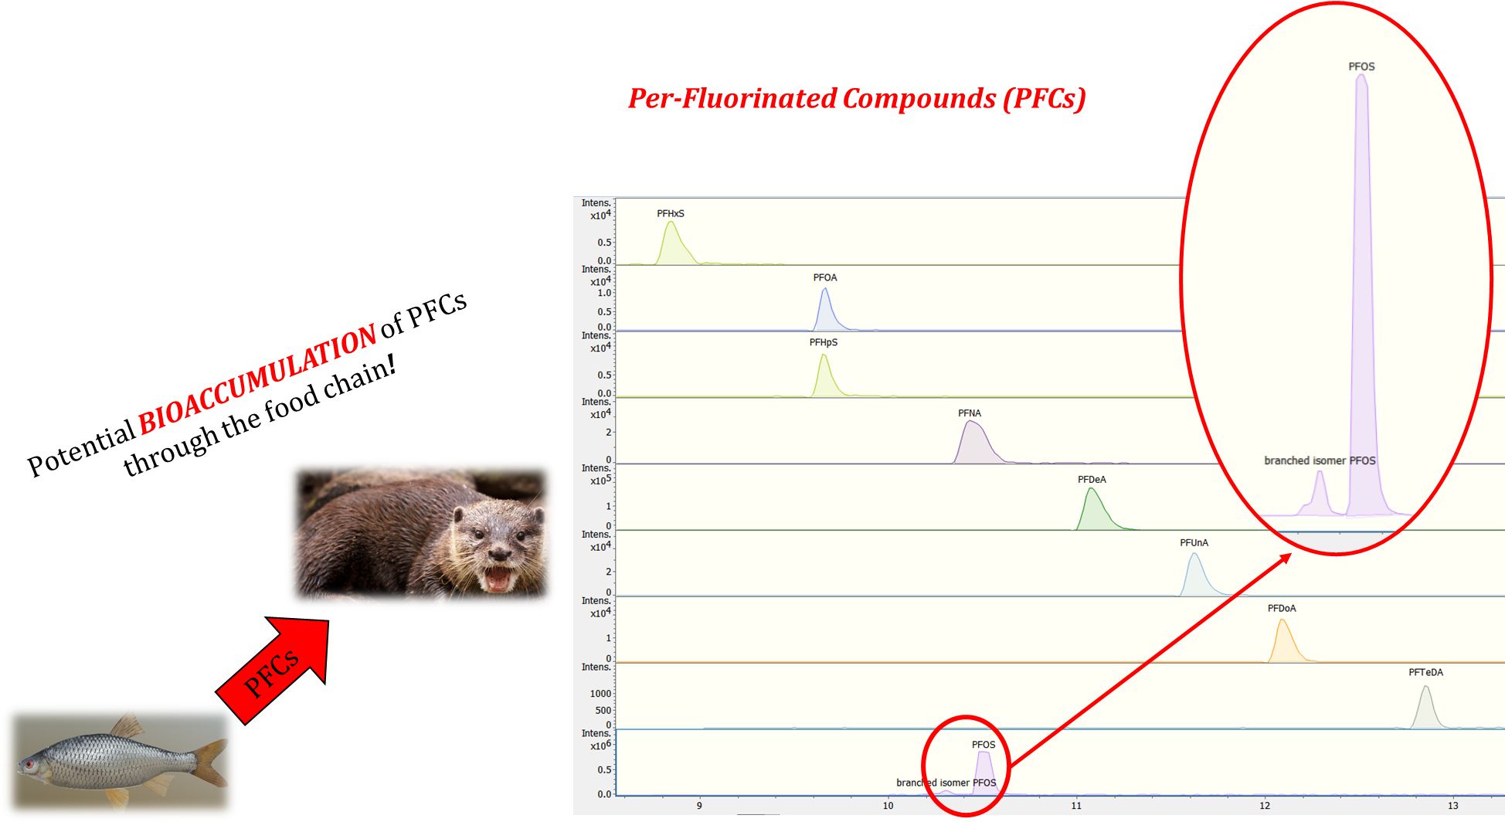
LIFE APEX Wide-scope target screning results
More than 15 Per-Fluorinated Compounds (PFCs) were detected in high intensities in all tested countries!

Slide 8



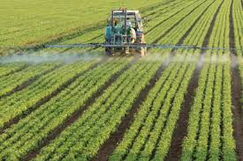

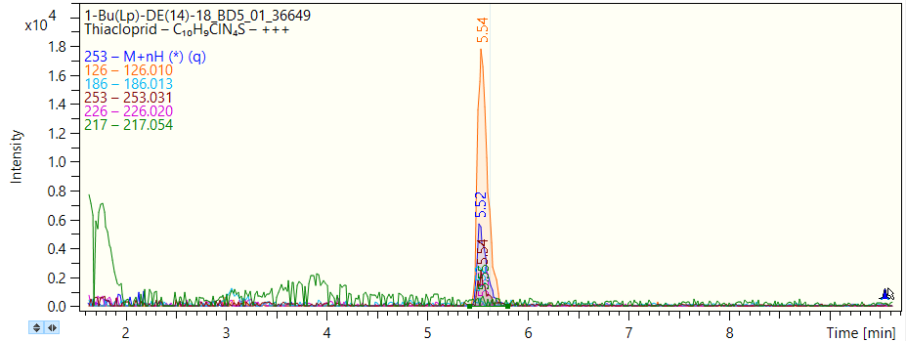
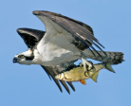
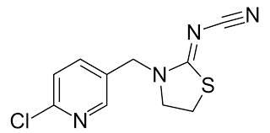
LIFE APEX Wide-scope target screning results
Plant Protection Products
… were also detected
Diuron
Fenuron
Simazine
Dinoterb
Myclobutanil
Terbuthylazine
Alachlor metabolite:
Alachlor-ESA
Thiacloprid

Slide 9
Non-target screening

Slide 10
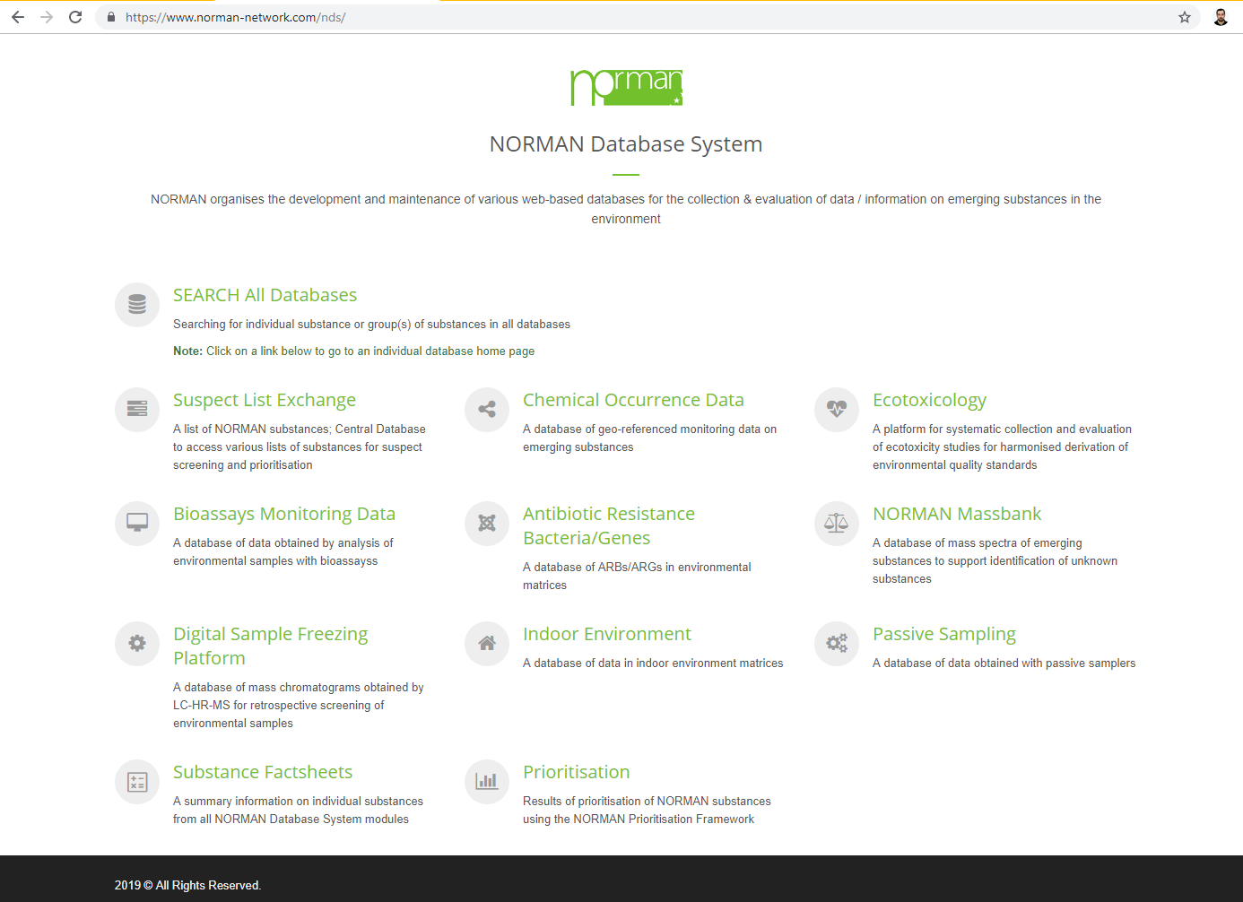
www.norman-network.com/nds/

Slide 11
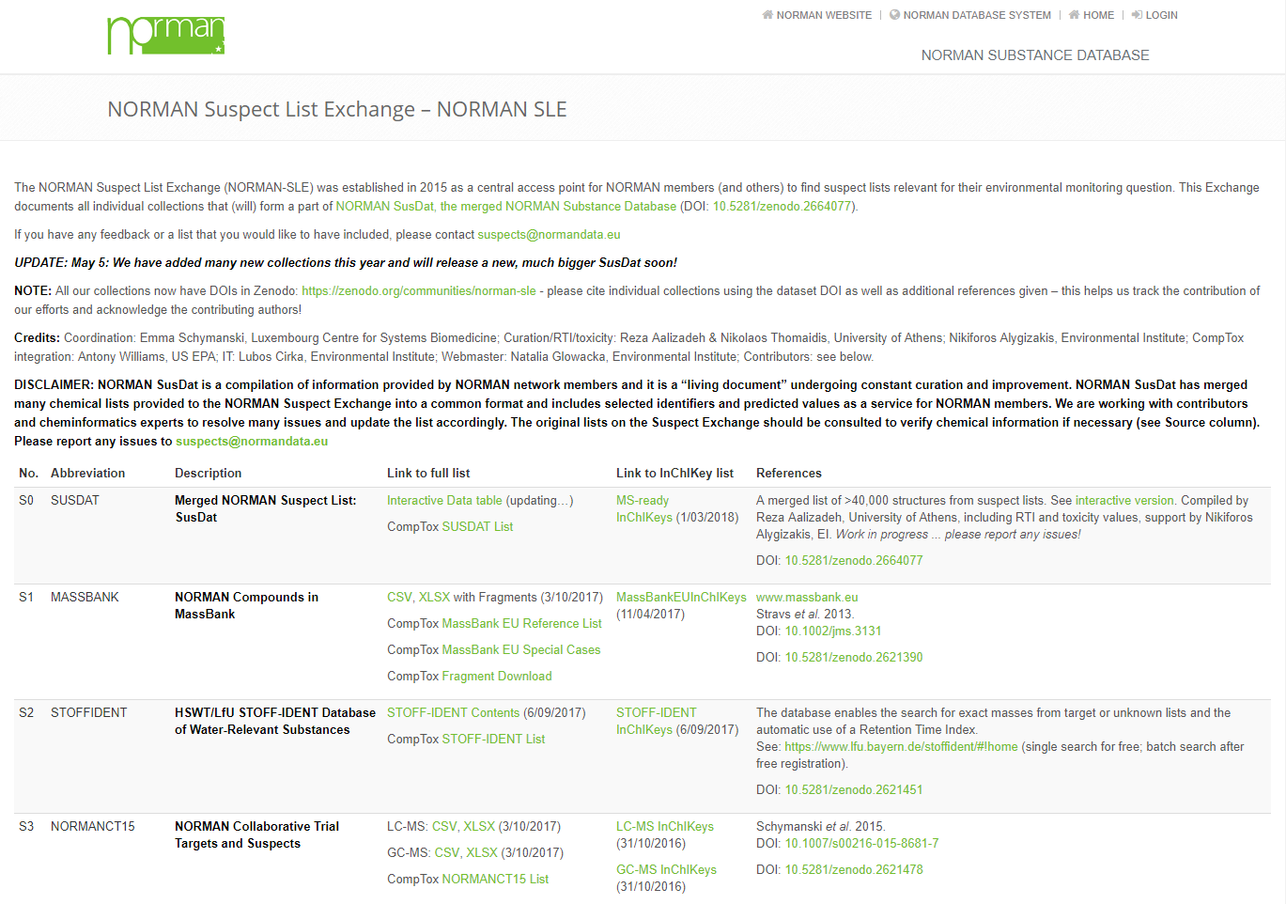
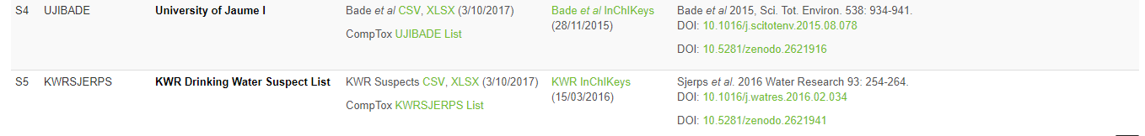

Slide 12
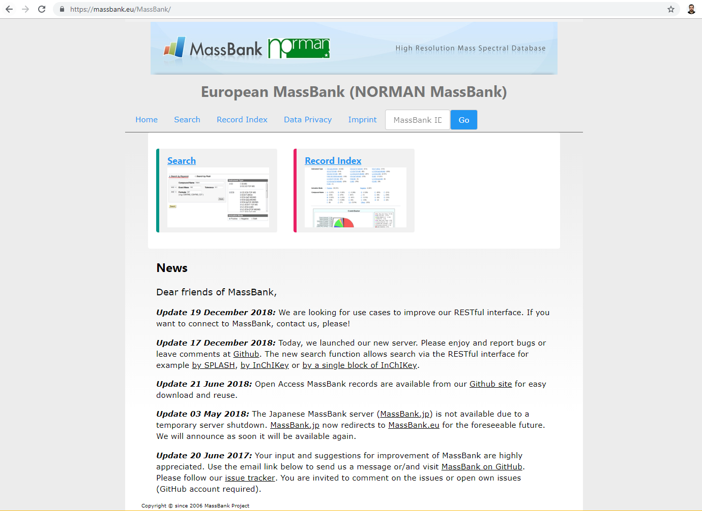

Slide 13
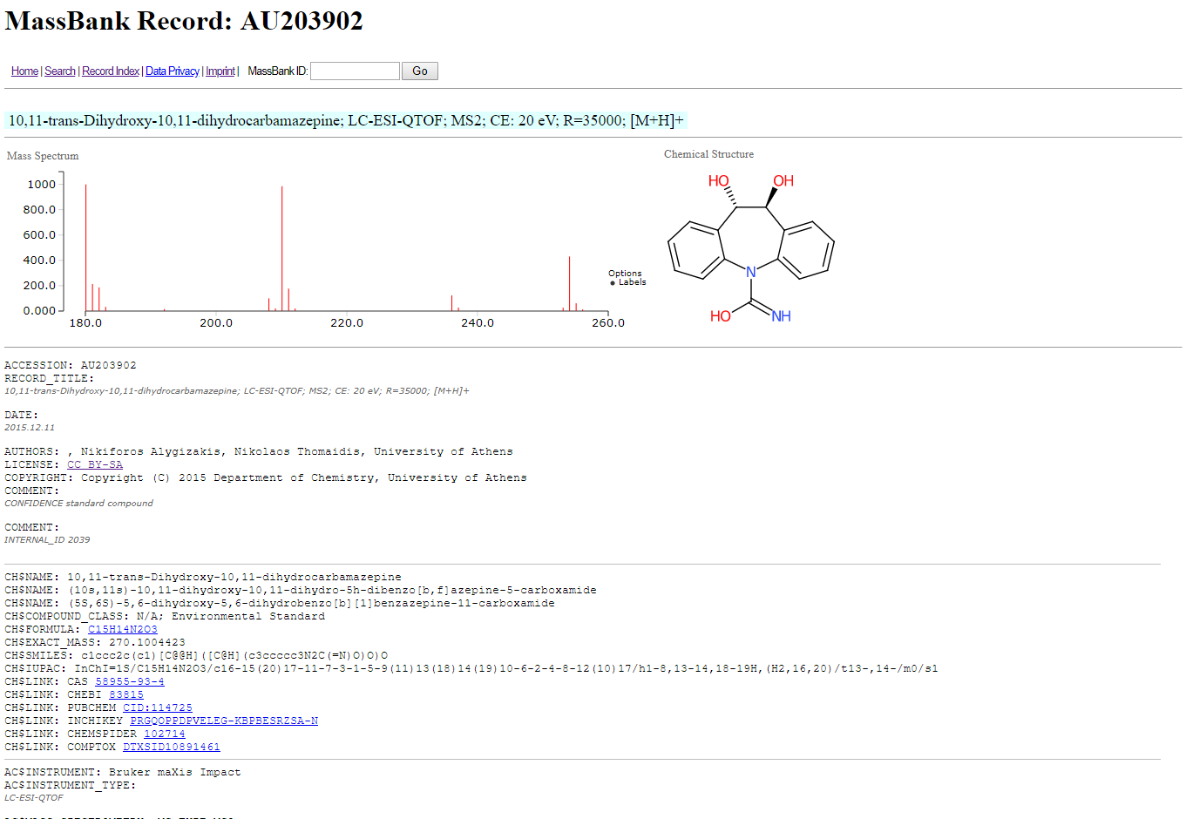
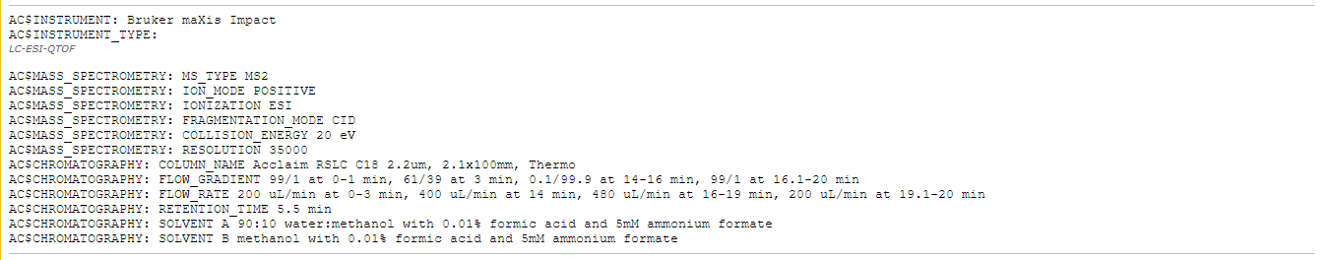

Slide 14
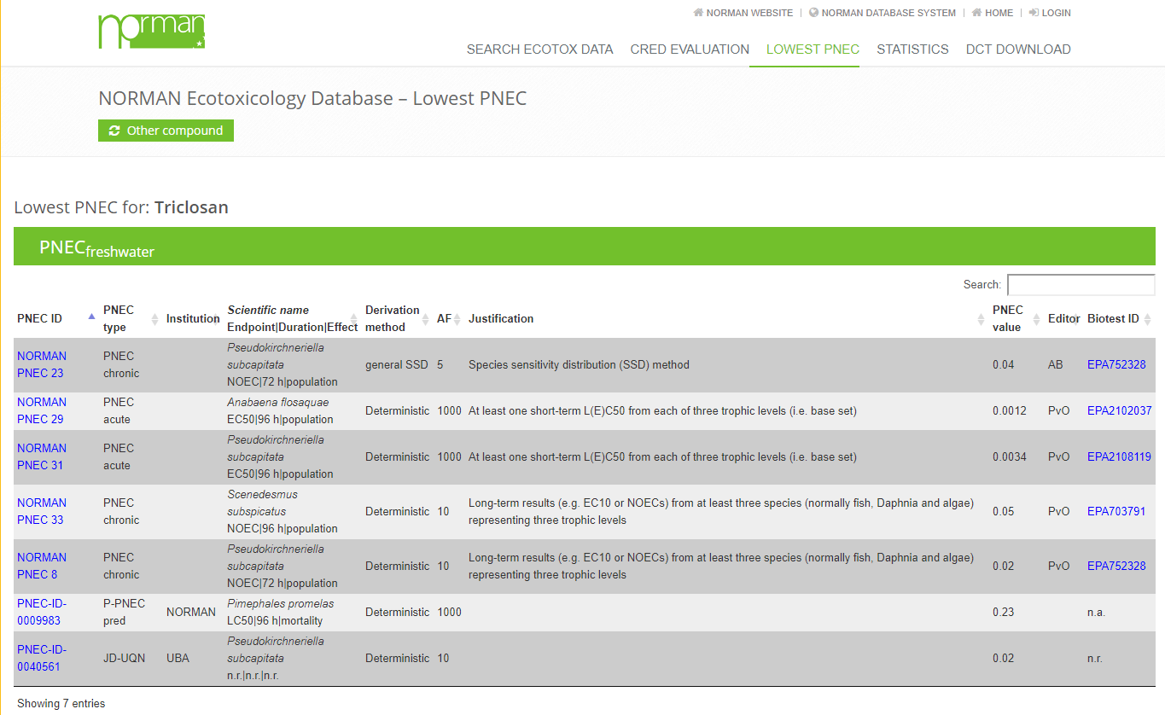
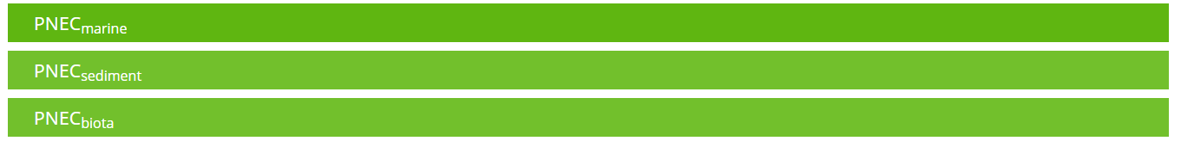

Slide 15
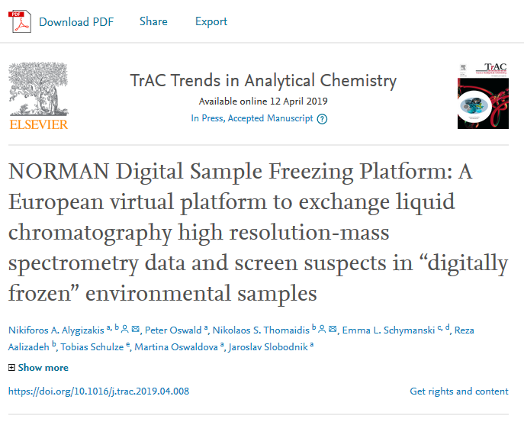
NORMAN DSFP

Slide 16
Alygizakis et al., 2019, TraC, DOI:10.1016/j.trac.2019.04.008 [Open Access]

Slide 17
Introduction

Slide 18

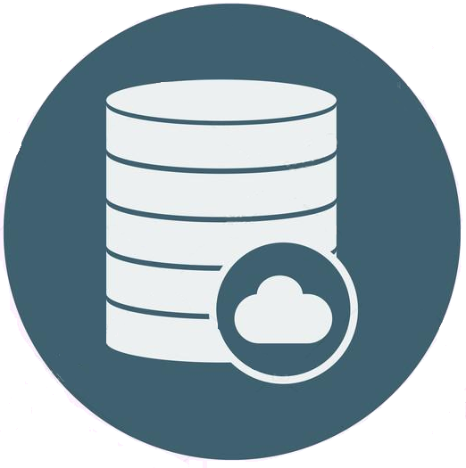
Organization (Organization details sheet in DCT)
NTS Data collection template
RTI (RTI sheet in DCT)
Sample description (Sample description sheet in DCT)
Instrumental Set up (Method LC-MS(MS) sheet in DCT)
Peak list (ANALYSIS sheet in DCT)
Fragment Peak list (Fragment sheet in DCT)
Spiked Compounds (Spiked compounds sheet in DCT)

Slide 19
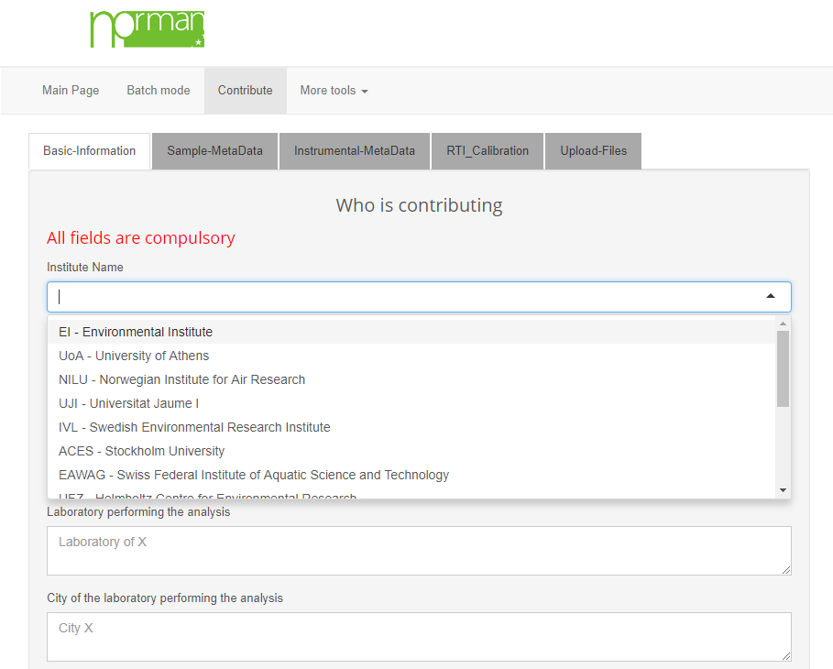
Upload chromatograms to DSFP

Slide 20
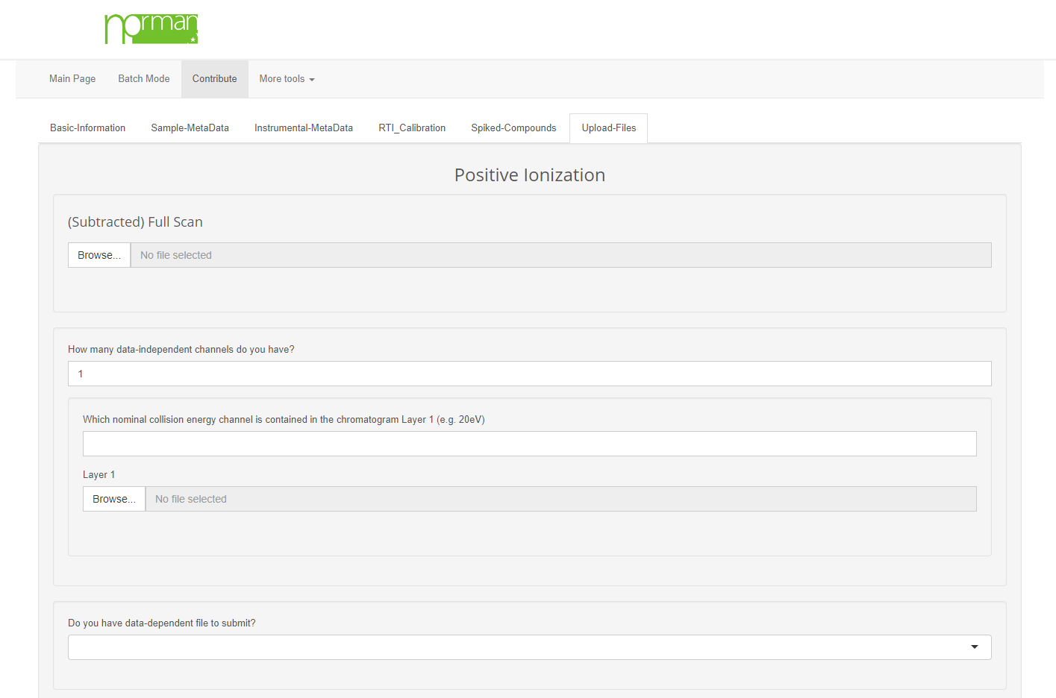
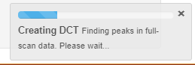
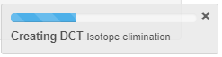
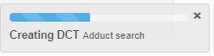
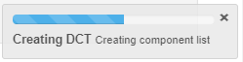
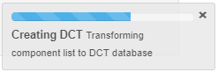
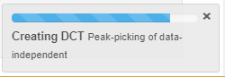
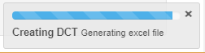
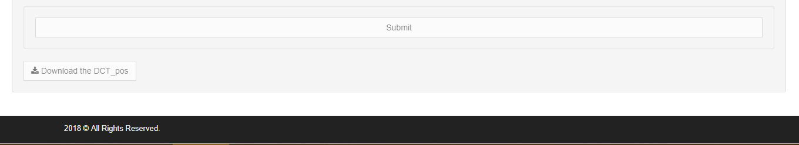
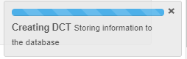
Upload chromatograms to DSFP

Slide 21
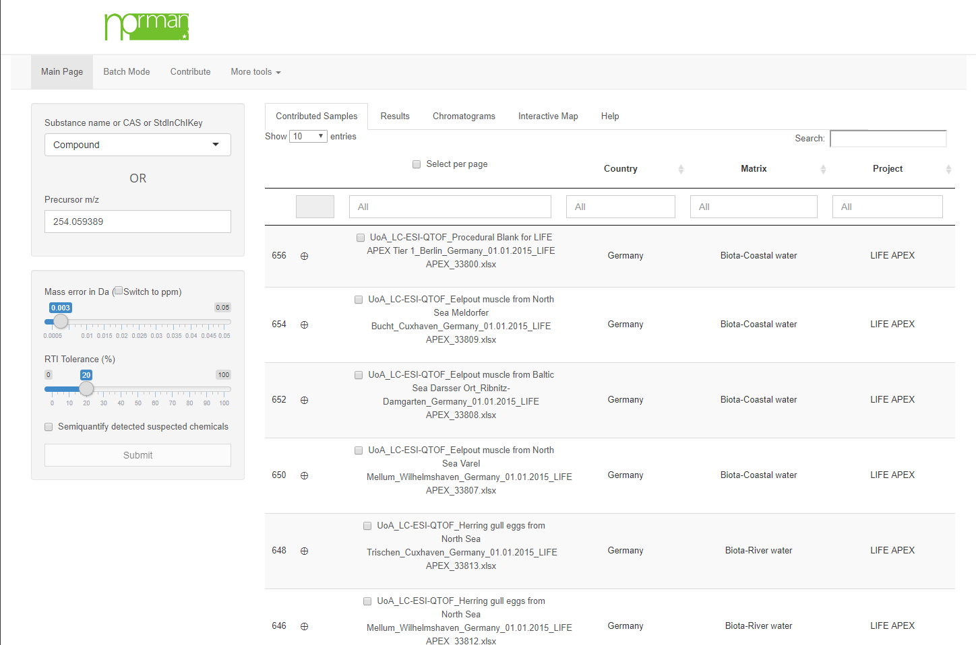
Single mode search

Slide 22
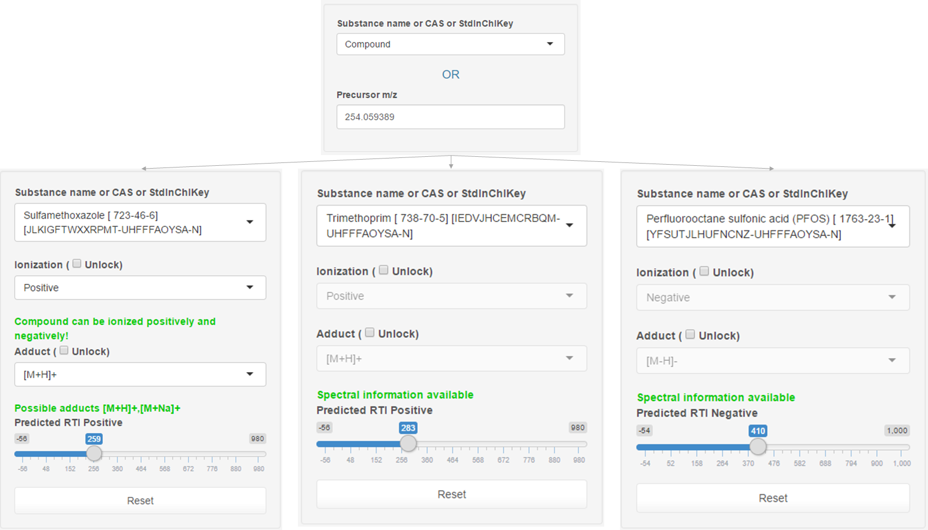

Compound selection
Compounds with prior-knowledge on spectral behavior:
Ionization pre-selection
Adduct pre-selection
Qualifier fragments in evaluation of chromatograms module

Slide 23
Single mode search

Slide 24
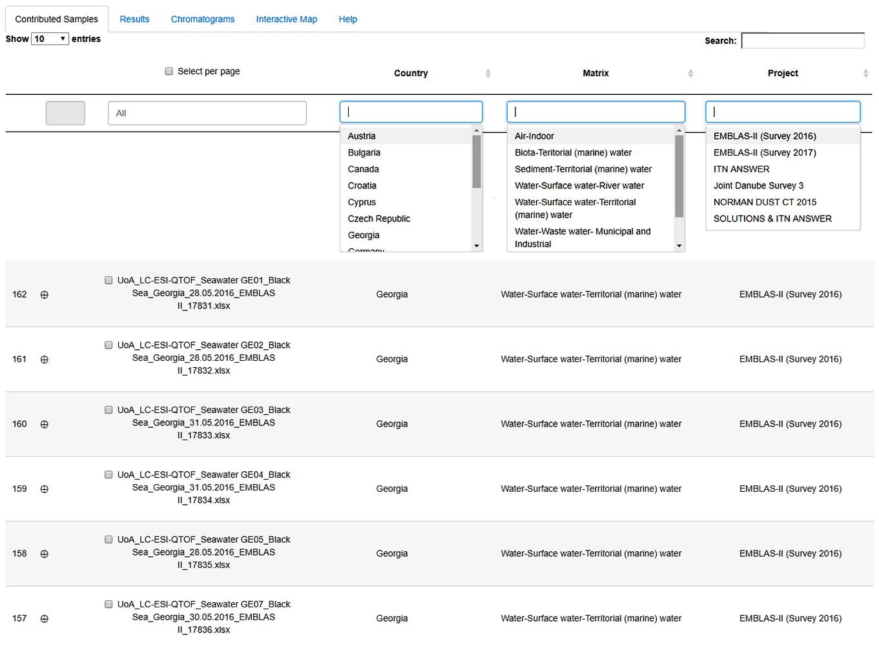
Chromatogram selection

Slide 25
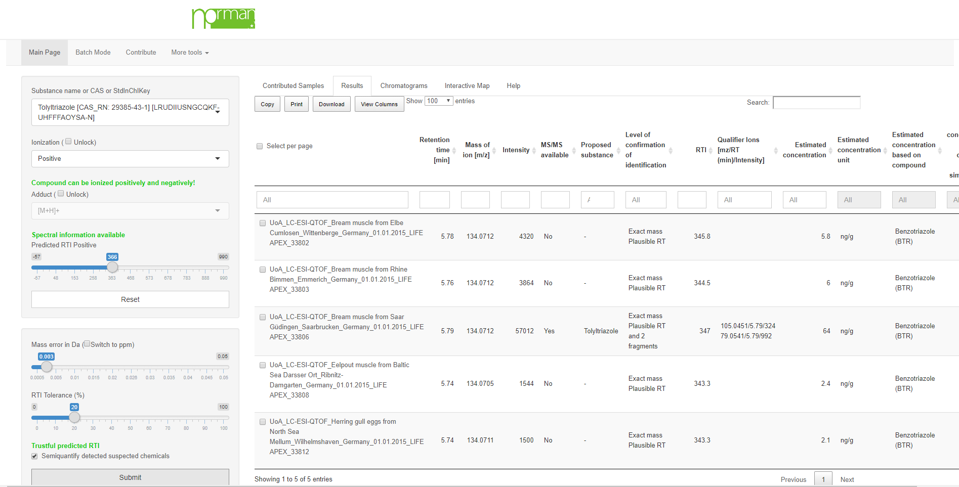
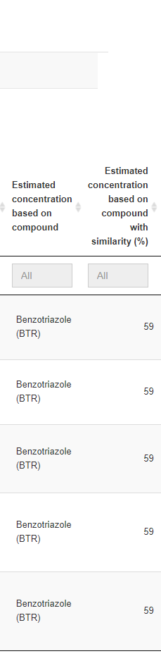
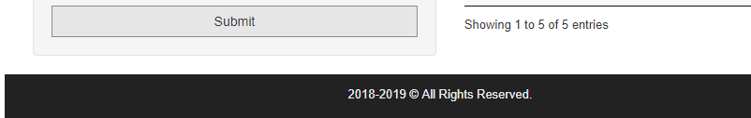
Validation of DSFP by target results
Tolyltriazole

Slide 26
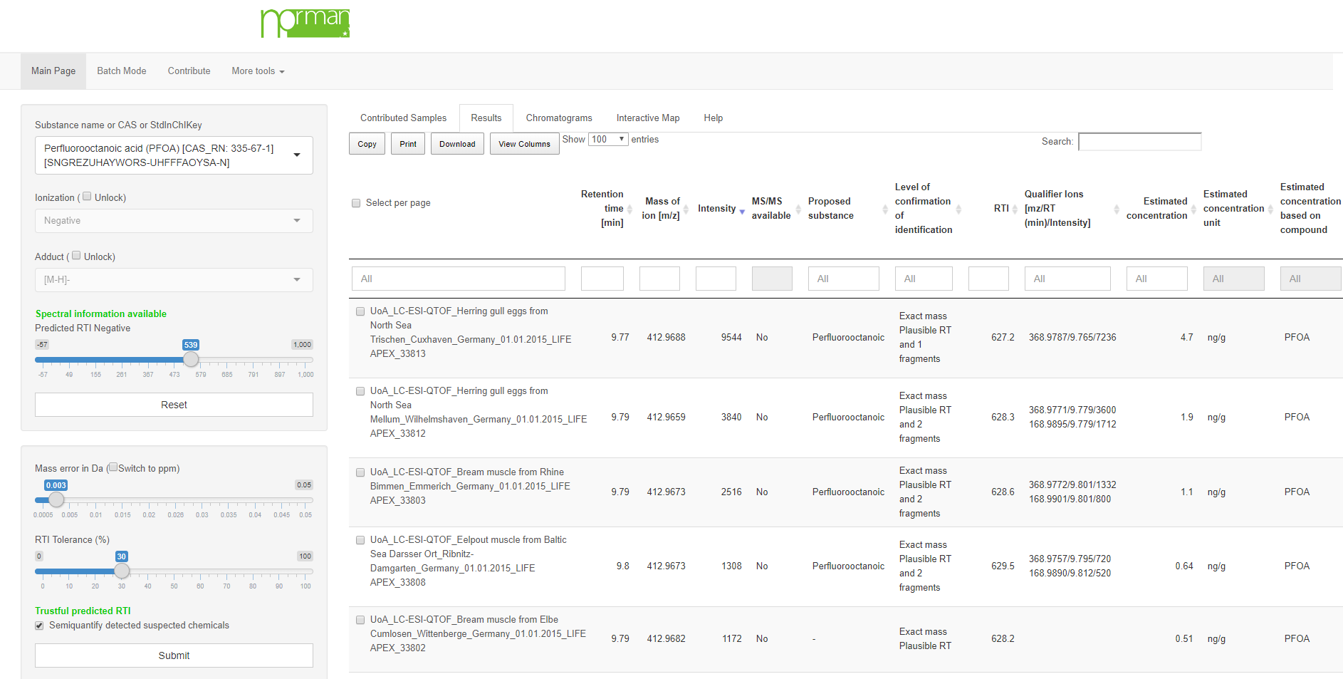
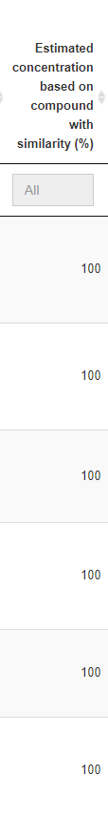
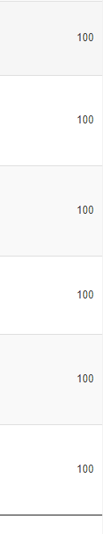
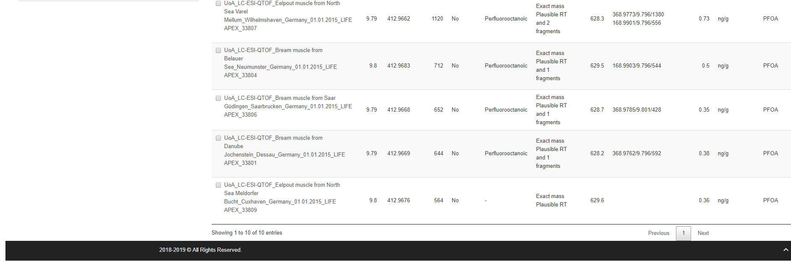

Validation of DSFP by target results
PFOA

Slide 27
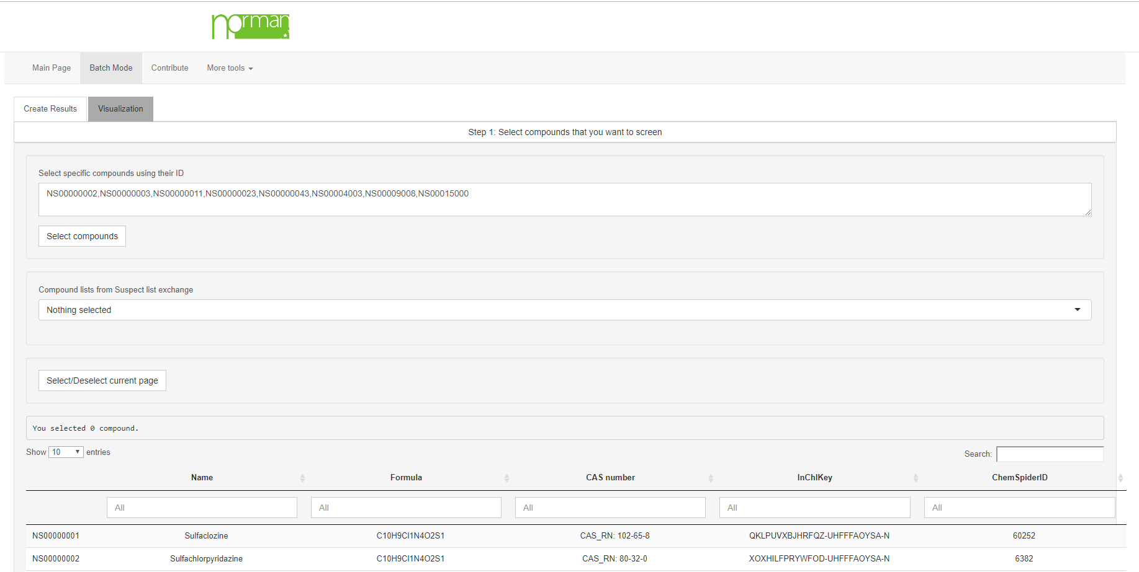
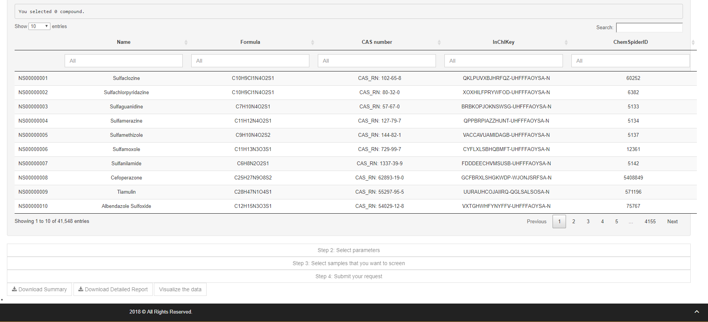
Batch-mode request 1/4

Slide 28
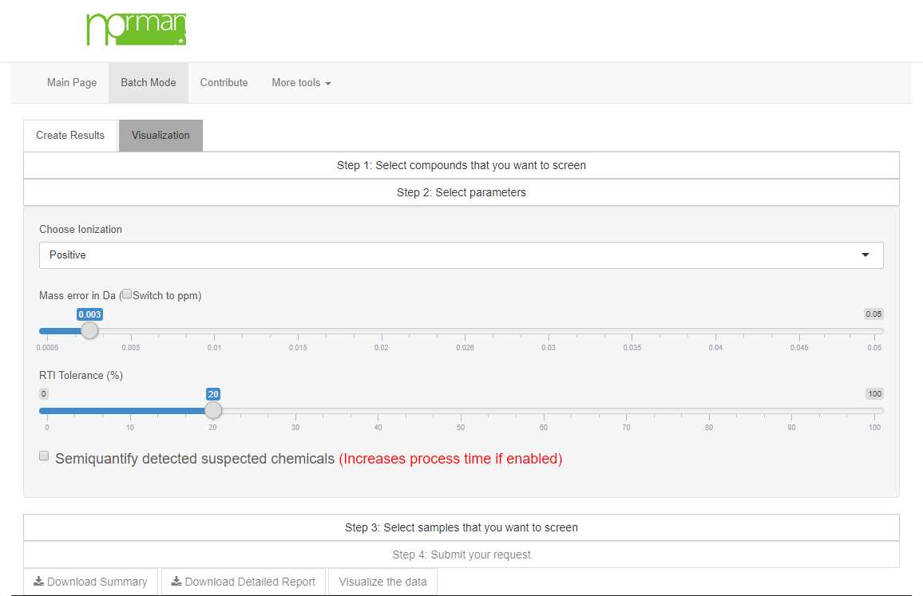
Batch-mode request 2/4

Slide 29
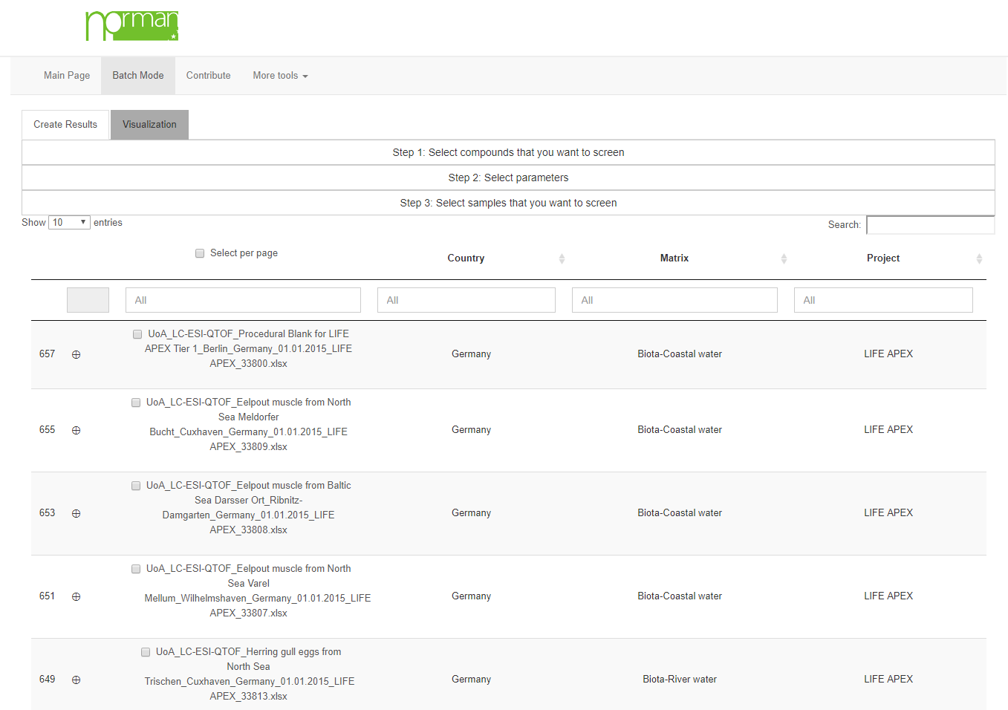
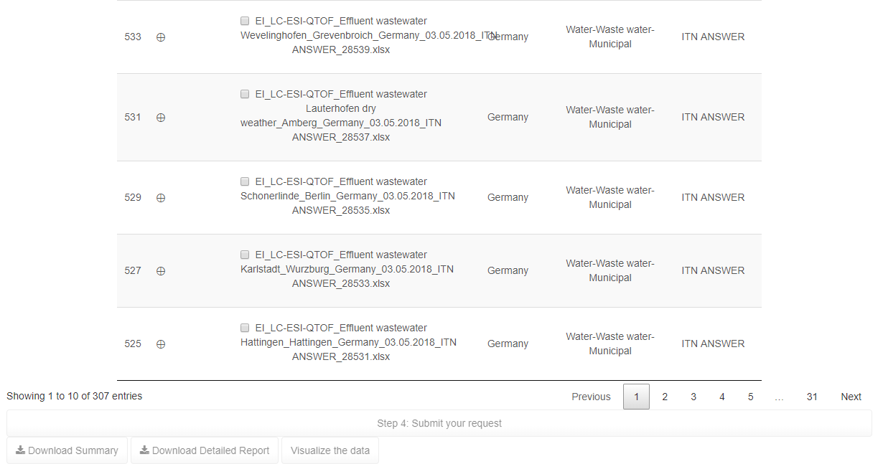
Batch-mode request 3/4

Slide 30
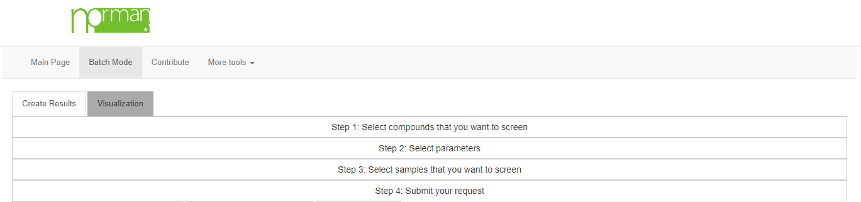
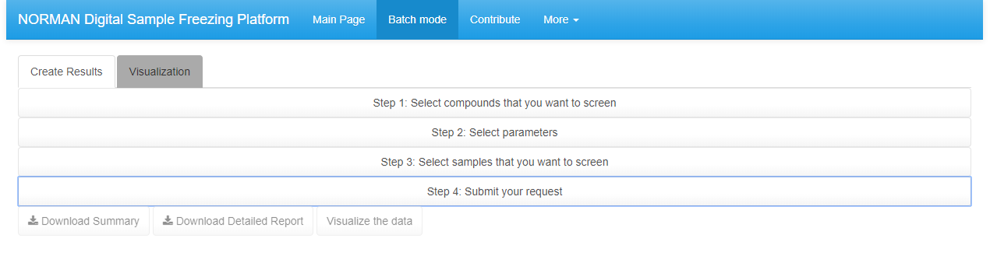





Batch-mode request 4/4

Slide 31





Output Summary

Slide 32



https://norman-data.eu/LIFE_APEX_H

Slide 33





Screening of REACH chemicals in JBSS
Interactive heatmap available at http://norman-data.eu/NORMAN-REACH
Alygizakis et al., 2019, TraC, DOI:10.1016/j.trac.2019.04.008

Slide 34







Thanks for your attention!
Acknowledgments:
LIFE17 ENV/SK/000355
More information at www.lifeapex.eu

